Slide 1
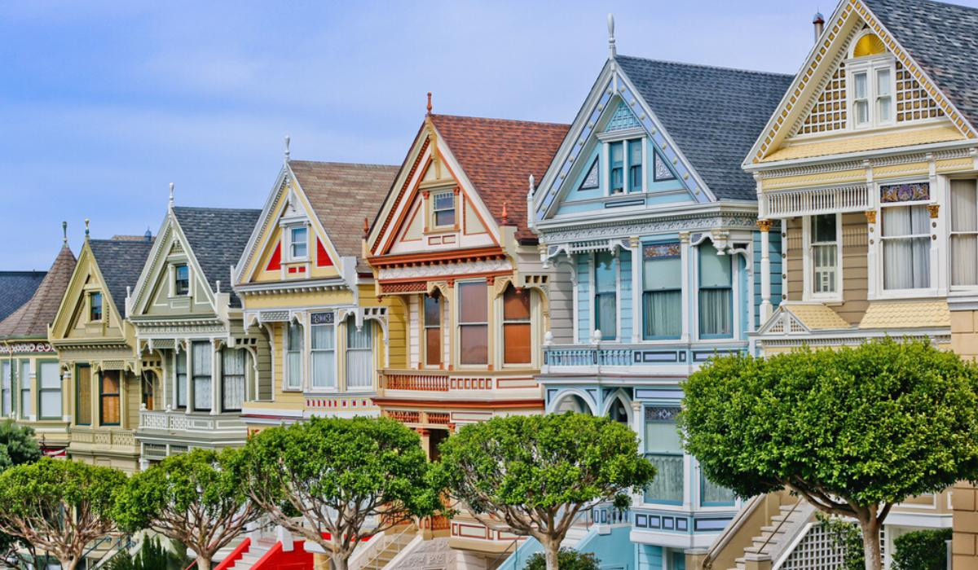



4 WEEKS INDUSTRIAL TRAINING
PROJECT
HOUSING PRICE PREDICTION USING MACHINE LEARNING
NAME: PRABHJOT KAUR (12300402)
EMAIL: PKSARAI88@GMAIL.COM
SECTION: C04A
GITHUB: GITHUB.COM/PKSARAIII/12300402
LINKEDIN: LINKEDIN.COM/IN/PKSARAIII

Slide 2


CONTENT
01
02
03
04
INTRO
PROJECT OBJECTIVE
DATASET OVERVIEW
DATA PREPROCESSING
05
06
07
08
EDA
ML MODELS USED
RESULTS & ANALYSIS
CONCLUSION

Slide 3



ABOUT US
AI and ML are transforming industries by helping systems learn from data and make accurate predictions. They improve automation, efficiency, and decision-making.
This project applies ML techniques to predict housing prices using data preprocessing, analysis, and regression models. It was completed during the Four-Week Industrial Training at AppTechies, Mohali.

Slide 4



WHY IT MATTERS
01
Helps homebuyers and sellers make informed decisions by providing realistic estimates of housing prices based on data analysis.
02
Assists real-estate investors in evaluating properties, identifying opportunities, and planning investments more effectively.
03
Reduces reliance on guesswork by offering accurate, data-driven predictions derived from historical trends and key property features.

Slide 5





OBJECTIVES
Prediction
Preprocessing
Feature Selection
Insights
Use different ML algorithms (e.g. Linear Regression, Random Forest, XGBoost) to predict housing prices and compare their performance.
Prepare the dataset (handle missing values, encode categorical values , scale/ normalize, etc.) so that the ML models can learn correctly from data.
Identify which features (house area, location, number of rooms, other attributes) most influence price and use feature-engineering to improve model accuracy.
Offer predictions that can guide buyers, sellers, and real-estate investors for informed decision-making based on estimated house values.

Slide 6
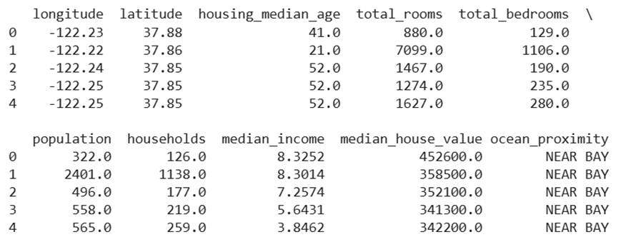
DATASET USED (HOUSING.CSV)
The dataset contains housing information including geographic coordinates (longitude, latitude), property attributes (housing_median_age, total_rooms, total_bedrooms, population, households), economic data (median_income), and target variable (median_house_value). The categorical feature ocean_proximity indicates the location relative to the ocean.
This dataset is used to predict housing prices based on various demographic, geographic, and economic factors.

Slide 7




DATA PREPROCESSING
Data Preprocessing is the process of cleaning and transforming raw data into a suitable format for analysis or machine learning, ensuring accuracy and consistency.
Feature Scaling & Selection
Encoding Categorical Features
Handling Missing Values & Outliers

Slide 8

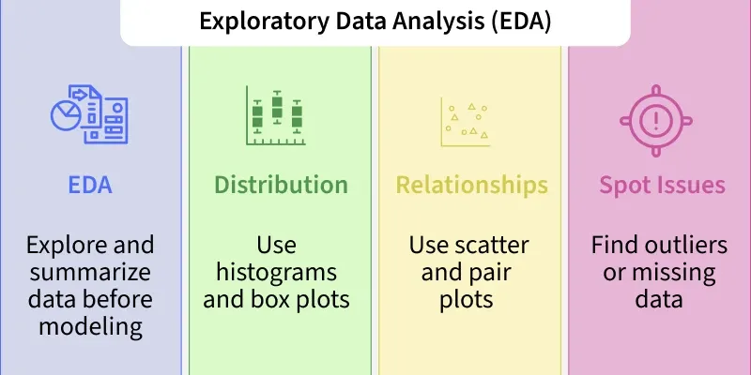
EXPLORATORY DATA ANALYSIS (EDA)
Exploratory Data Analysis (EDA) involves examining and visualizing the dataset to understand its structure, patterns, and relationships. It includes analyzing feature distributions, identifying outliers with box plots, exploring correlations through heatmaps, visualizing trends via scatter and regression plots, and assessing feature importance to guide model building. EDA ensures the data is clean, consistent, and ready for accurate predictions.

Slide 9






MACHINE LEARNING MODELS USED
Linear Regression
Decision Tree Regressor
A basic regression model that predicts housing prices based on a linear relationship between features and the target variable.
A tree-based model that splits data into subsets based on feature values to predict continuous outcomes.
Random Forest Regressor
XGBoost Regressor
An ensemble of decision trees that improves accuracy and reduces overfitting by averaging predictions from multiple trees.
An advanced gradient boosting model that builds trees sequentially, optimizing for error reduction and high predictive performance.

Slide 10






RESULTS & ANALYSIS
Combined Regression
Scatter Plot
Heatmap
Shows the relationship between two variables, helping detect trends or correlations.
Displays correlations between features using color gradients, highlighting strong or weak relationships.
Compares predictions from multiple models against actual values in a single visualization for performance evaluation
Box Plot
Regression Plot
Feature Importance Plot
Visualizes the distribution of numerical data and identifies outliers through quartiles and whiskers.
Plots actual vs predicted values to evaluate the fit of a regression model.
Ranks features based on their contribution to the model’s predictions.

Slide 11
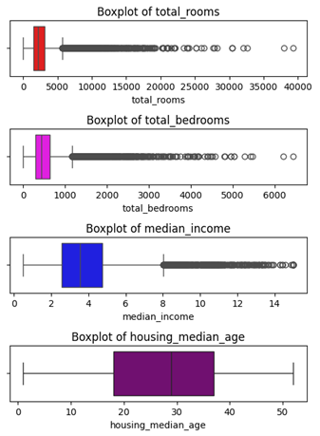
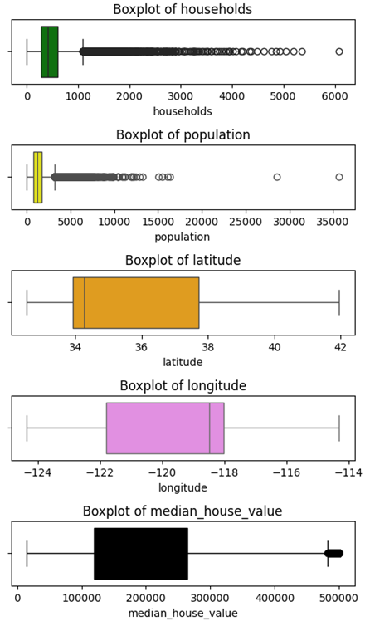
1. BOX PLOTS:
Purpose: Detect outliers and understand the distribution of individual features.

Slide 12
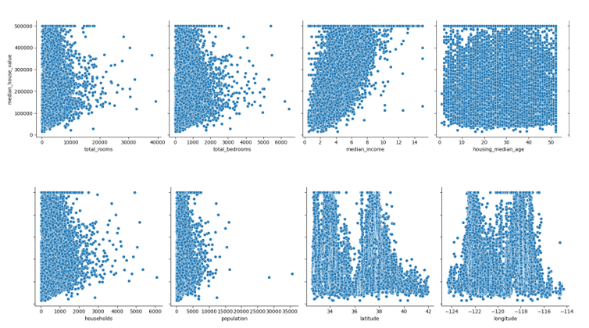
2. SCATTER PLOTS:
Purpose: Visualize the relationship between two variables.

Slide 13
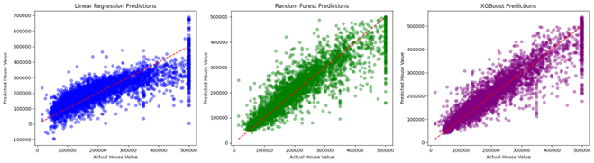
3.LINEAR REGRESSION PLOTS
Purpose: Show how well the model predicts house prices compared to actual values.

Slide 14
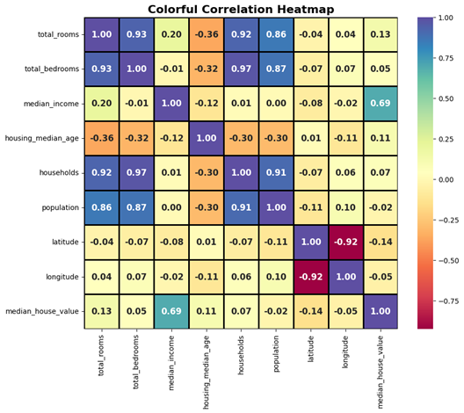
4.CORRELATION MAP
Purpose: Show linear relationships between all features and the target (price).

Slide 15
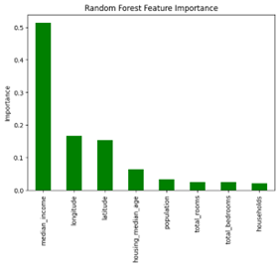
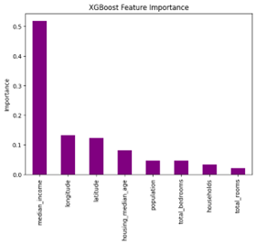
5. FEATURE IMPORTANCE
Purpose: Identify which features have the most impact on predicting house prices.

Slide 16
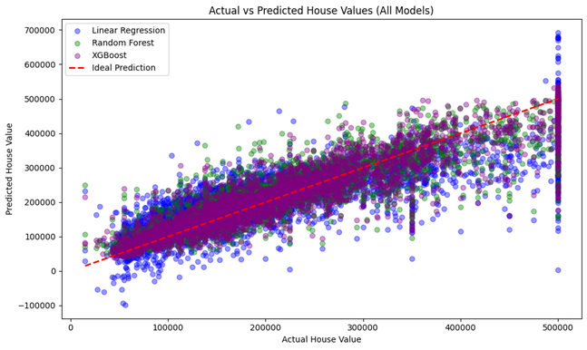
6.COMBINED REGRESSION PLOTS
Purpose: Overlay regression lines on scatter plots for multiple features at once..

Slide 17
CONCLUSION
IN THIS PROJECT, WE SUCCESSFULLY BUILT MACHINE LEARNING MODELS TO PREDICT HOUSING PRICES USING A CLEANED AND PREPROCESSED DATASET. EXPLORATORY DATA ANALYSIS (EDA) INCLUDING BOX PLOTS, SCATTER PLOTS, AND CORRELATION HEATMAPS HELPED US UNDERSTAND FEATURE DISTRIBUTIONS, RELATIONSHIPS, AND OUTLIERS. LINEAR REGRESSION, ALONG WITH TREE-BASED MODELS, SHOWED THAT FEATURES LIKE AREA, LOCATION, AND NUMBER OF BEDROOMS ARE THE MOST INFLUENTIAL IN DETERMINING HOUSE PRICES. COMBINED REGRESSION PLOTS AND FEATURE IMPORTANCE ANALYSIS CONFIRMED THE RELIABILITY OF OUR PREDICTIONS. OVERALL, THE MODELS ACHIEVED REASONABLE ACCURACY, DEMONSTRATING THAT DATA-DRIVEN APPROACHES CAN EFFECTIVELY ASSIST BUYERS, SELLERS, AND INVESTORS IN MAKING INFORMED HOUSING DECISIONS.

Slide 18

THANK'S FOR WATCHING

